Slide 1

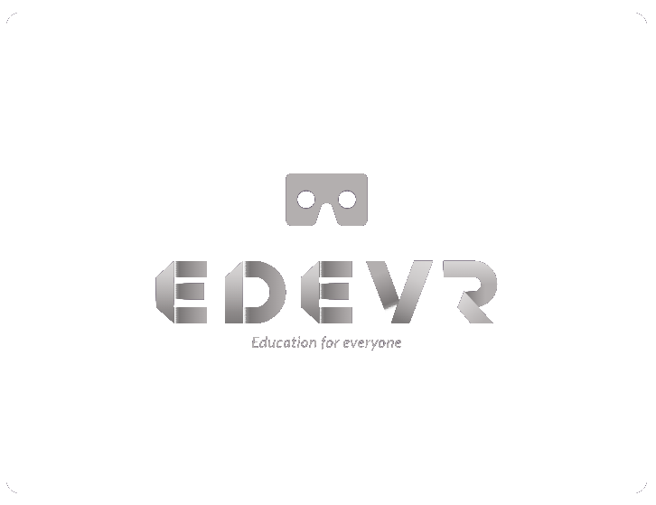




EDUCATION
FOR EVERYONE
B
Notes:
Hello everyone! good afternoon to one and all present here, I am Biancaa, Me and my friends are going to present on the topic edevr, Basically our motive is education for everyone. Benjamin Franklin once said: An investment in knowledge pays the best interest.

Slide 2





WHATS
EDEVR?
EDeVR is an immersive learning platform, working towards a solution that lets children learn practical skills without access to real tools with hands-on exp while allowing the educators to push the boundaries of student engagement.
h

Slide 3

What is 'VR'?
VR or Virtual Reality, is the use of computer technology to create a simulated environment that can be explored in 360 degrees.
Unlike traditional interfaces, VR places the user inside the virtual environment for an immersive experience.
B

Slide 4

But what about Online Learning?
With conventional digital learning, students have more things to distract them.
and attention problems become more prevalent.
And without captivating teaching, students get frustrated.
r

Slide 5



WALKTHROUGH
Login
Explore the world of EdeVR
Subjects
Subjects varying from Geography
to Anatomy, Music to Chemistry,
and many more
VR Room
First Person View with the best real life experience
Bonus Features
Class Notes
Assignments
eBooks
Notice Board
Timetable
aj

Slide 6


FROM BOOKS
TO VR
QR codes beside appropriate concepts within textbooks to present students with 3D models.
B

Slide 7





Who Benefits?
STUDENTS
EDUCATORS
ADULTS
at

Slide 8



Martha's story
STEP1
Martha, a student, finds
it difficult to understand
a particular topic.
STEP2
Martha tries to understand
the topic by reading her book,
but ends up even more confused.
STEP3
Martha focuses by using
her VR classes and learns her VR lessons intently.
STEP4
Martha can finally understand her lessons! She is happier than ever.
B

Slide 9
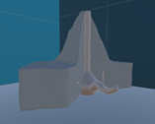
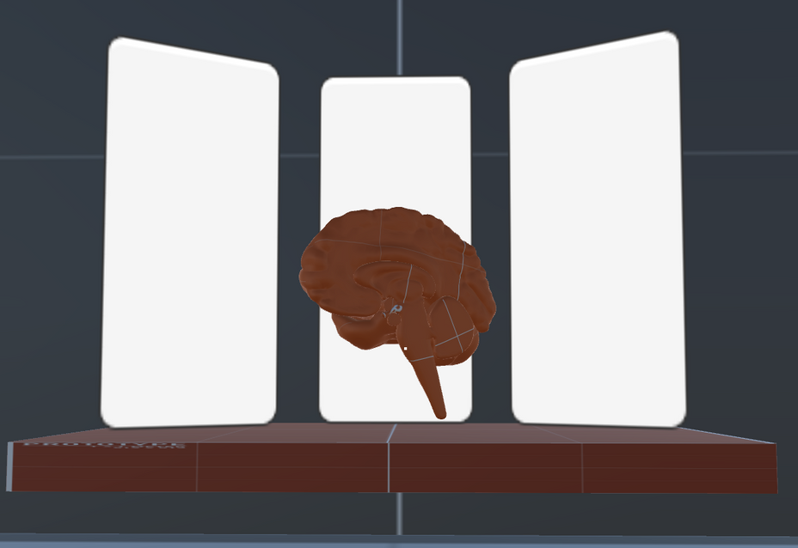
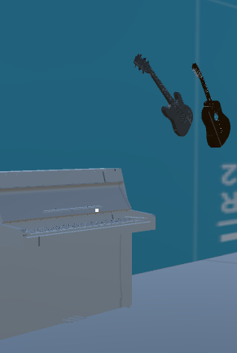

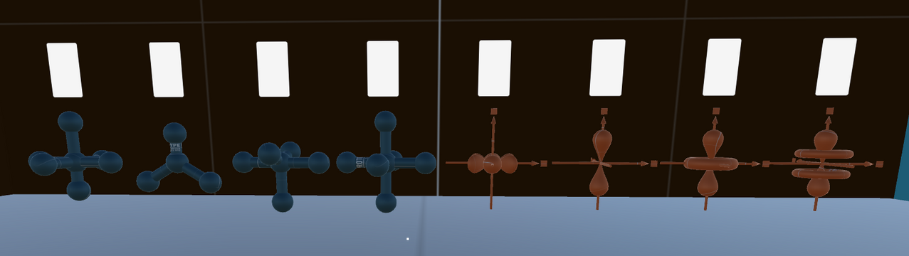
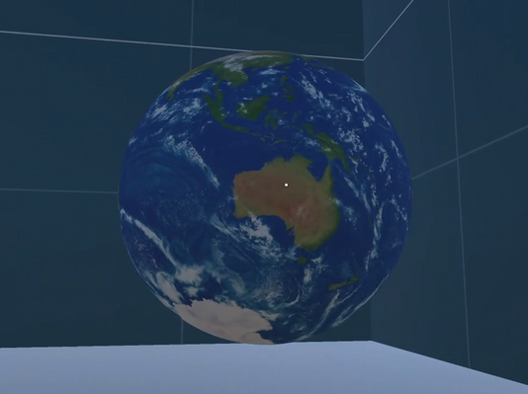
PROTOTYPE
Geography
Anatomy
Music
Chemistry
s

Slide 10

Demo

Slide 11

FUTURE PROSPECTS
1). Hologram vibrations for the Visually Impared
2). Higher education
3). Multilingual
4). Foreign Curriculum
5). Open Source

Slide 12

Team Members
Mentor - Ms. Vickie Culbertson
Saksham Sharma
Biancaa R
Anant Jain
Harshini Selvakumar
Aditya Tyagi
Dhruv Sai
Rishabh Bezbarua
h

Slide 13
Our experience
We enjoyed the power talks and had a chance to work with people from all over India and other countries. Our project sailed smoothly with the help of our mentor, Ms. Vickie Culberston. This was once in a lifetime experience and we're quite happy to be a part of it.

Slide 14
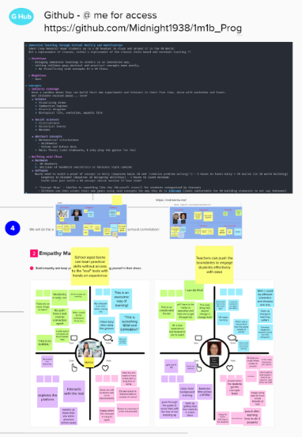
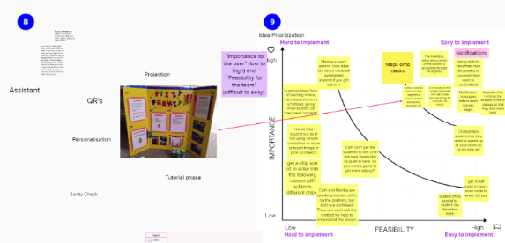
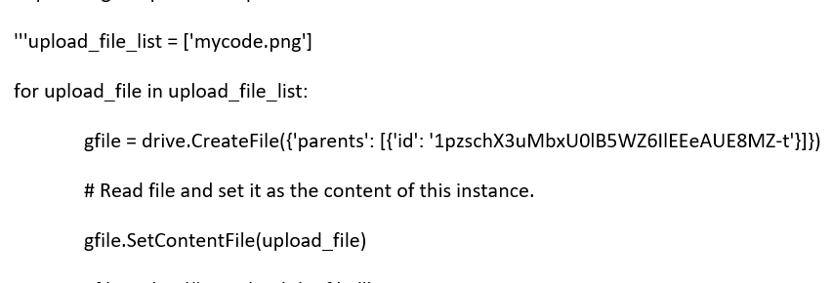
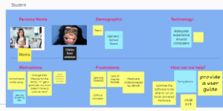
Behind the scenes

